Slide 1
Ontology Visualization: Search for Resource Evolution
Msc: i&m 2016-2017
Semantic Web
4th team
Trivizakis Eleftherios MTP143, providakis antonios MTP148

Slide 2
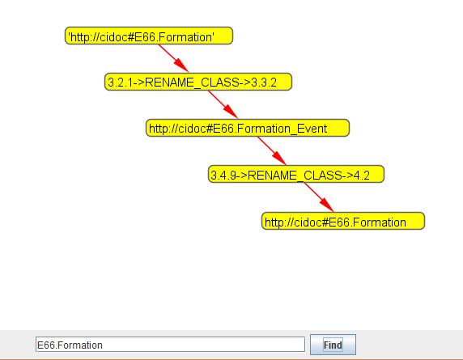
Tools & Development
Notepad++
Netbeans
JDK
CODE WRITTEN IN JAVA
PREFUSE
JENA
GUI – USER INTERACTION

Slide 3
Formulation of Problem & Algorithm
Search an resource with its URI
For multiple change operations
Over multiple owl files
Then depending the output
Repeat search with another change operations
Finally draw evolution graph (visualization)

Slide 4
Change Operations diagrams
Input Resource
rename
Rename class or property
Change Operator
generalize
Generalize domain or range or Pull down class
Changed Resource
add super
Add super class or property
delete super
Delete super class or property
change datatype
Change to Datatype property

Slide 5
Change Operations diagrams
Input Resource
add class
Add class
Change Operator
delete class
Delete class
Changed Resource
delete property
Delete property
add property
Add property

Slide 6
Ontology Evolution Visualizer
Changes of resources (OWL)
GUI
EvoFinder
Resource URI
Change Operation
Graph
EvoViz

Slide 7
Ontology Evolution Visualizer
OntologyEvolutionVisualizer
GraphView.java
Ontologies
VirtuosoService.java
SimpleGraph.java
QueryConstructor.java
User’s Input
User’s Desired Output
Java Classes

Slide 8

Flow of Execution
v3.2.1-v3.3.2.owl
OntologyEvolutionVisualizer
v3.3.2-v3.4.9.owl
Virtuoso
v3.4.9-v4.2.owl

Slide 9
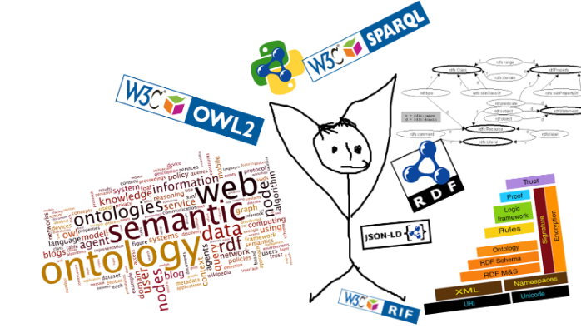
THX!

Slide 10
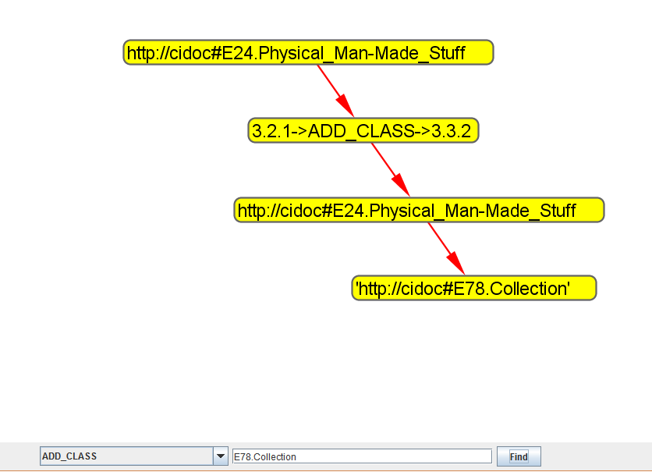
Tools & Development
Notepad++
Netbeans
JDK
PREFUSE
JENA
CODE WRITTEN IN JAVA
GUI – USER INTERACTION

Slide 11
Change Operators’ diagrams
Input Resource
Change Operator
rename
Rename class or property
Changed Resource
add class
generalize
Add class
Generalize domain or range or Pull down class
delete class
Delete class
add super
Add super class or property
delete property
Delete property
delete super
Delete super class or property
add property
Add property
change datatype
Change to Datatype property

Slide 12
System Architecture
v3.2.1-v3.3.2.owl
OntologyEvolutionVisualizer.jar
v3.3.2-v3.4.9.owl
virtuoso
v3.4.9-v4.2.owl

Slide 13
Flow of Execution
v3.2.1-v3.3.2.owl
1
8
OntologyEvolutionVisualizer.jar
v3.3.2-v3.4.9.owl
4
Virtuoso
5
3
v3.4.9-v4.2.owl
7

